Slide 1
Recursion and Search Algorithms
Lab 8

Slide 2
Recursive Functions
A recursive function is a function that calls itself
With each recursive call, the problem size is reduced
The function terminates when a terminal condition is reached
Recursion must terminate; otherwise, we have infinite recursion
A recursive definition consists of two parts.
The first part is called the anchor or the base case.
In the second part, rules are given that allow for the construction of new elements out of basic elements.

Slide 3
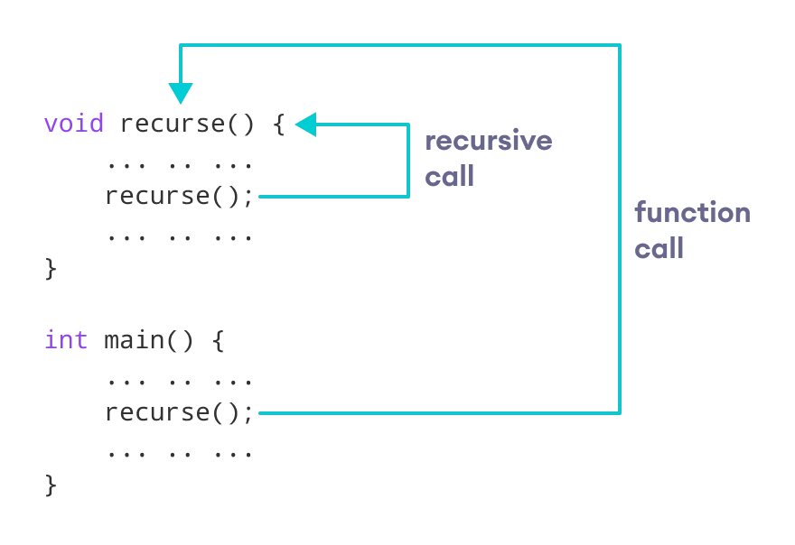
Recursive Functions

Slide 4
recursiveFunction: if (base case){ // there could be more than one base case compute the solution without recursion } else { break the problem into sub-problem(s) of the same form and call the recursive function on each sub-problem Assemble the results of the sub-problems }

Slide 5
Three Musts for Recursion
1. Your code must have a valid case for each input
2. Your code must have at least one base case
3. When making a recursive call, it must be a simpler instance that progresses towards the base case

Slide 6
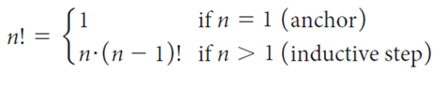
The factorial function !
The factorial function ! , can be defined in the following manner:
6! = 6*5*4*3*2*1=720

Slide 7
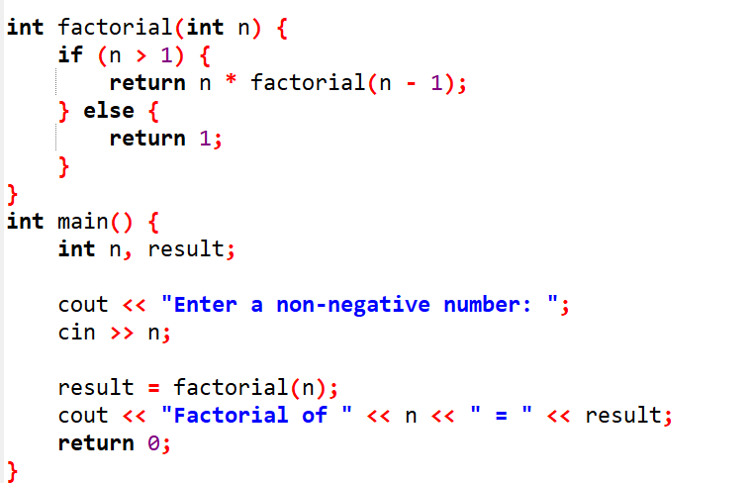
The factorial function !

Slide 8


Slide 9
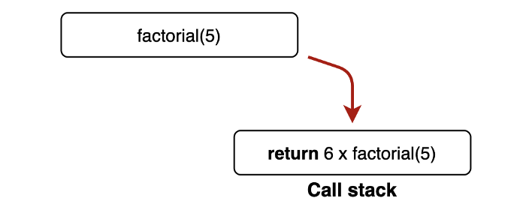

Slide 10
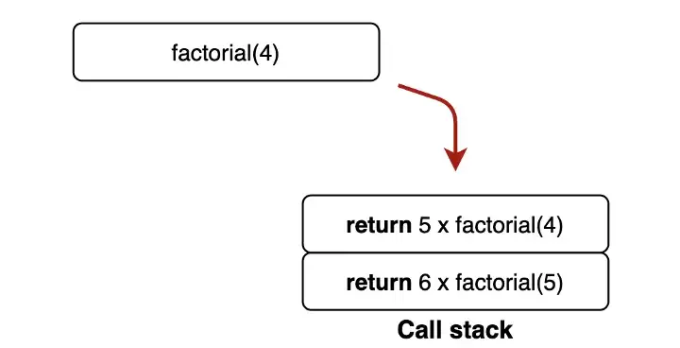

Slide 11
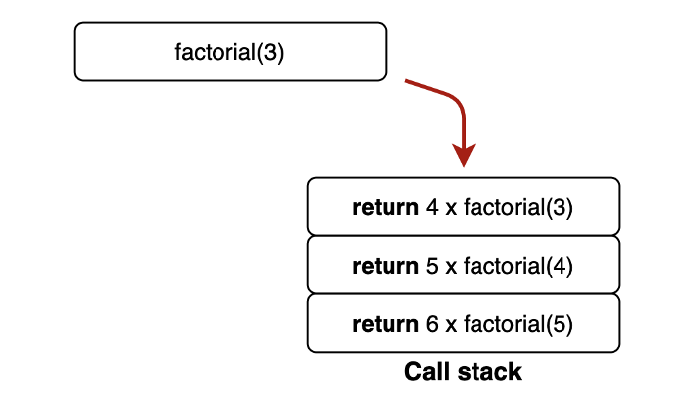

Slide 12
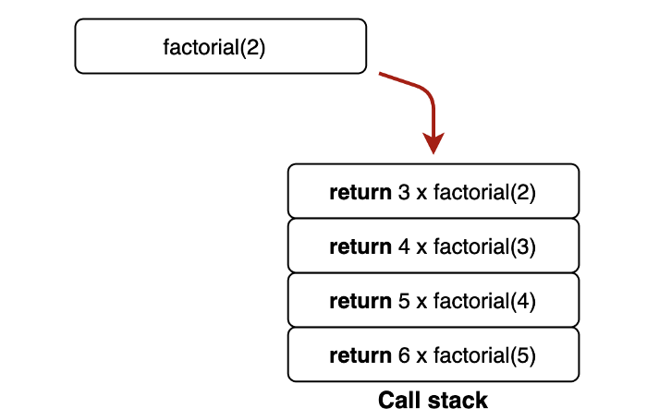

Slide 13
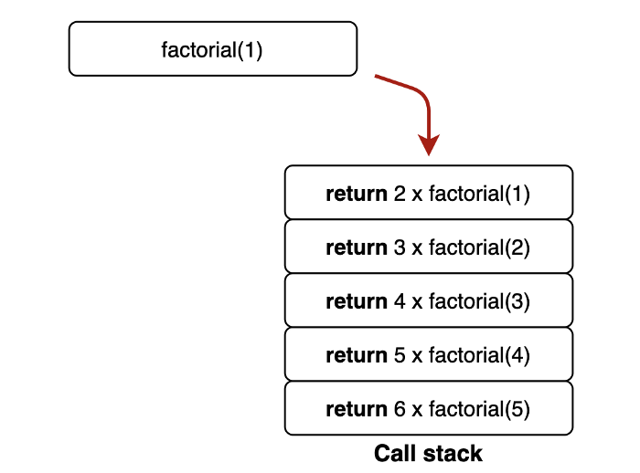

Slide 14
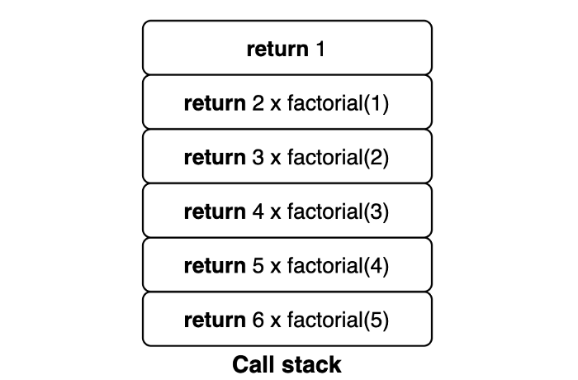

Slide 15
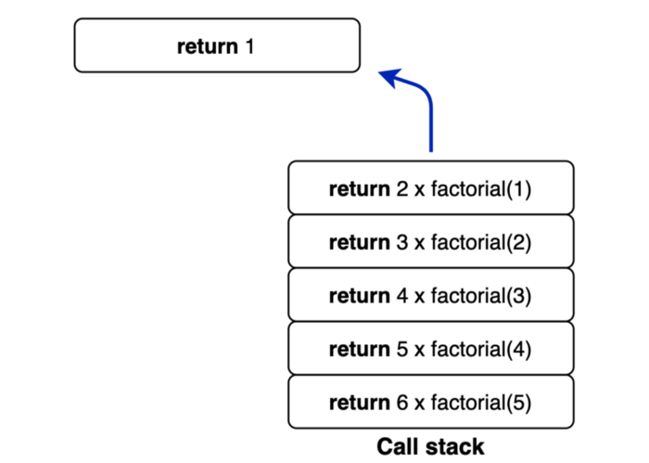

Slide 16
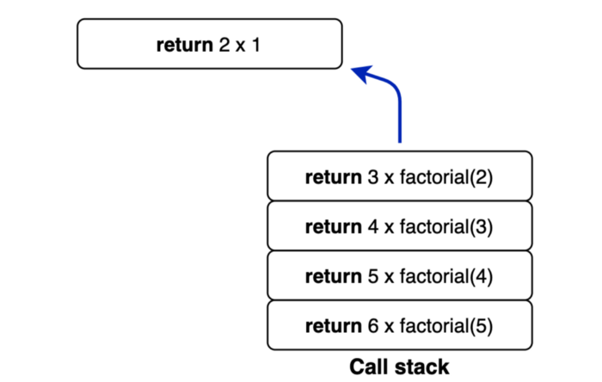

Slide 17
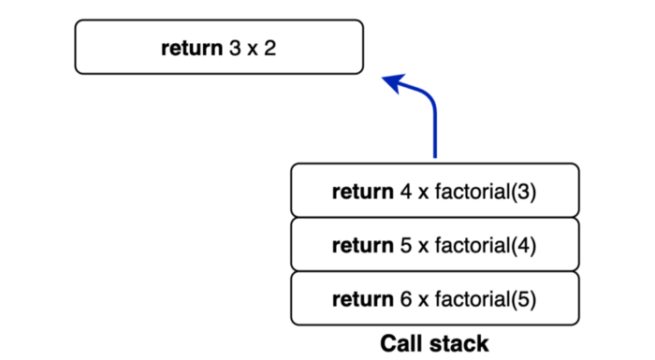

Slide 18
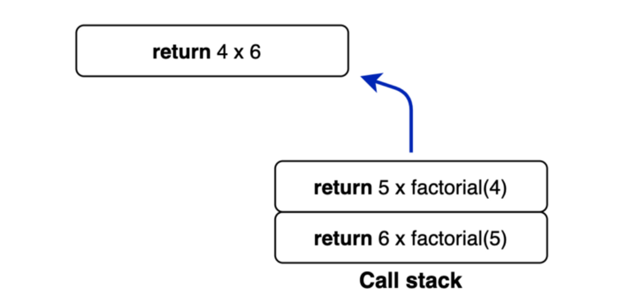

Slide 19
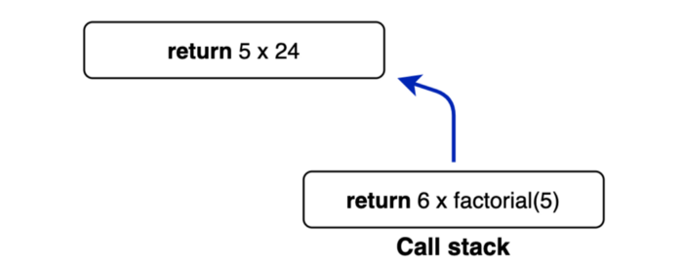

Slide 20
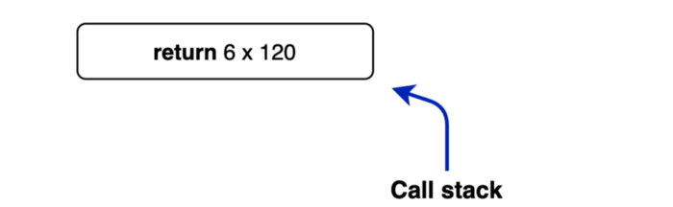

Slide 21
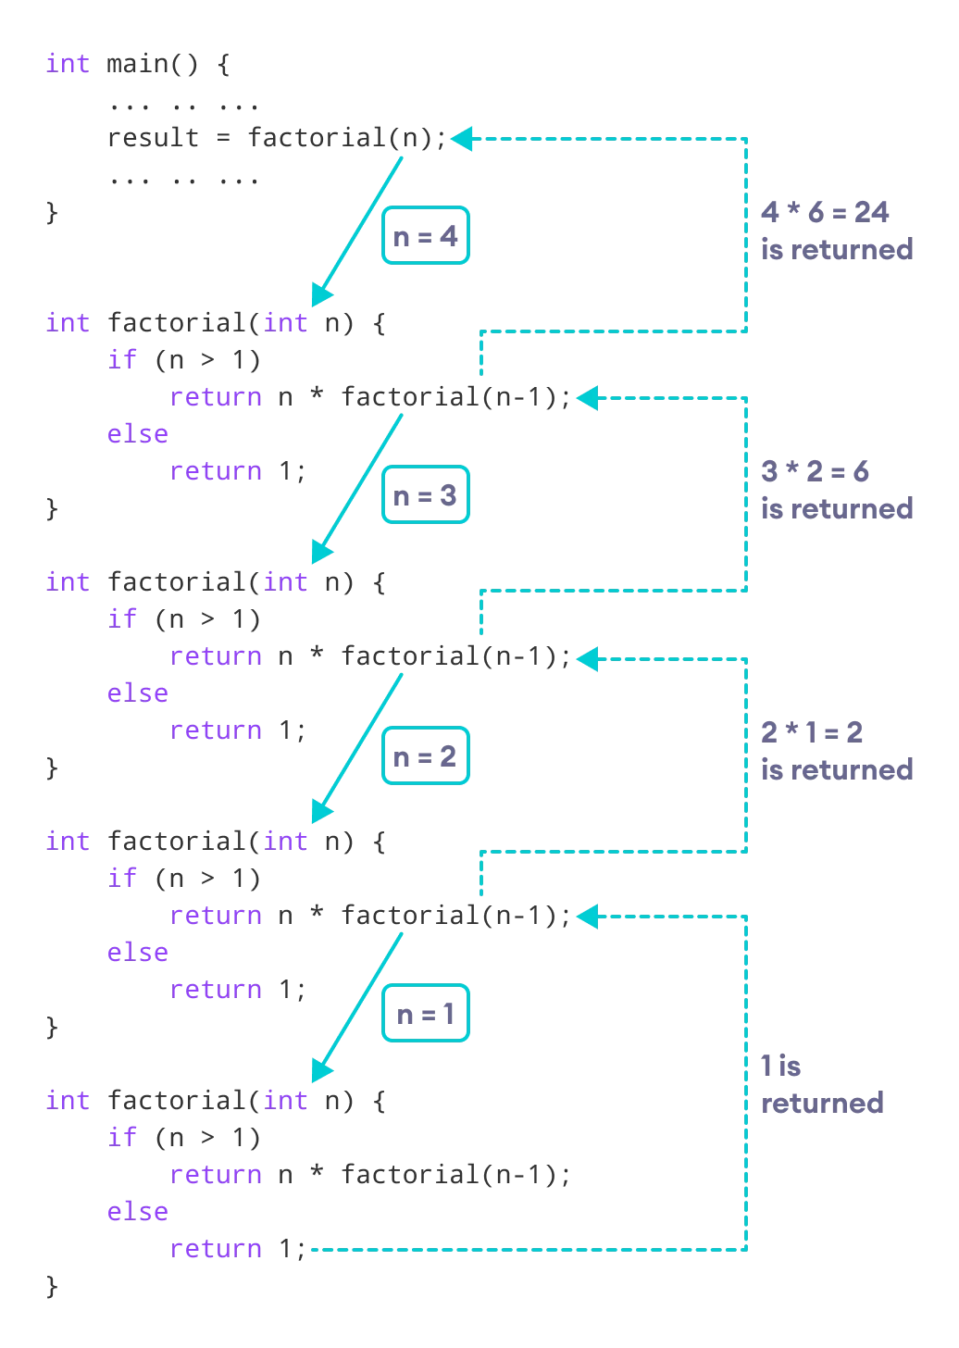
The factorial function !

Slide 22
Search Algorithms
Linear (Sequential) Searching Algorithm
Can deal with unsorted arrays
Binary Searching Algorithm
Must deal with sorted arrays

Slide 23

Linear Search Algorithm
Compare target value with all elements of the array until you find a match or reach the last element in the array
EX: arr = [25,30,6,17,27,11], n = 6, target = 17
17
25 | 30 | 6 | 17 | 27 | 11
Found

Slide 24
Linear Search Algorithm
int linSearch(int list [ ], int listLength, int key)
{
int loc;
for(loc = 0; loc < listLength; loc++)
{
if(list[loc] == key)
return loc;
}
return -1;
}

Slide 25
Linear Search Algorithm
The best case time complexity of linear search takes place when the element to be searched for is on the first index → Time complexity is 1
The worst case will take place if:
The element to be search is in the last index
The element to be search is not present in the list
→ Time Complexity is N

Slide 26
Recursive Linear Search
-1 if n<=0
f(a, n, target) n-1 if target=a[n-1]
f(a, n-1,target) Otherwise

Slide 27
Recursive Linear Search
int linearSearch(int a[], int n, int target) {
// Recursive version of linear search
if (n <= 0) // an empty list is specified
return -1;
else {
if (a[n-1] == target) //test final position
return n-1;
else // search the rest of the list recursively
return linearSearch(a, n-1, target);
}
}

Slide 28
Binary Search Algorithm
Can only be performed on a sorted list !!!
Uses divide and conquer technique to search list

Slide 29
Binary Search Algorithm
Search item is compared with middle element of list
If search item < middle element of list, search is restricted to first half of the list
If search item > middle element of list, search second half of the list
If search item = middle element, search is complete

Slide 30
Binary Search Algorithm
Search for (7)
0 | 1 | 2 | 3 | 4 | 5 | 6 | 7 | 8 | 9 | 10 | 11 | 12
2 | 4 | 5 | 7 | 8 | 9 | 11 | 14 | 17 | 20 | 27 | 31 | 34
0 | 1 | 2 | 3 | 4 | 5
2 | 4 | 5 | 7 | 8 | 9
3 | 4 | 5
7 | 8 | 9
3
7
Found

Slide 31
Binary Search Algorithm
int binarySearch(int [ ] list, int listLength, int key)
{
int first = 0, last = listLength - 1;
int mid;
boolean found = false;
while (first <= last && !found) {
mid = (first + last) / 2;
if (list[mid] == key)
found = true;
else
if(list[mid] > key)
last = mid - 1;
else
first = mid + 1;
}
if (found)
return mid;
else
return –1;
} //end binarySearch

Slide 32
Binary Search Algorithm
The Best Case Complexity - occurs when the element to search is found in first comparison → Time complexity is 1
The Worst Case Complexity - occurs, when we have to keep reducing the search space till it has only one element → Time Complexity is LogN

Slide 33
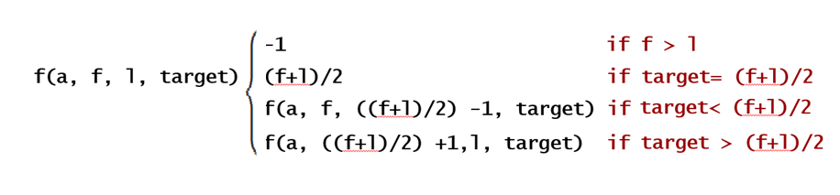
Recursive Binary Search

Slide 34
Recursive Binary Search
int binarySearch(int a[], int first, int last, int target)
{
// Preconditions: a is an array sorted in ascending order, first is the index of //the first element to search, last is the index of the last element to //search, target is the item to search for.
if (first > last)
return -1; // -1 indicates failure of search
int mid = (first+last)/2;
if (a[mid] == target)
return mid;
else if (target < a[mid]) // left/lower sub-array
return binarySearch(a, first, mid-1, target);
else // target must be > a[mid] // right/upper sub-array
return binarySearch(a, mid+1, last, target);
}

Slide 35
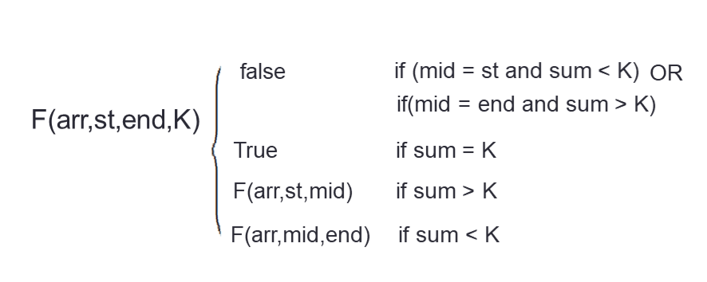
Task
Implement function that check if an array has two sequential numbers that their sum is K using concept of recursion and binary search where the array is sorted
Ex: arr = [6,8,9,10,15] , K = 17 -> True
Ex: arr = [5,12,20,25,30] , K = 38 -> False

Slide 36
Bonus
The same of previous task but use linked list instead of array

Slide 37
Thank You

